Slide 1


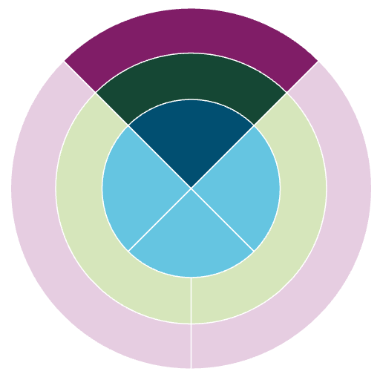
Creating your Development Needs Analysis (DNA)
The four activities in this form have been designed to guide you in tailoring your Development Needs Analysis (DNA). These can be completed in any order, depending on where you are in your studies. There is no right or wrong answer to these activities. Take time to reflect on each activity and write your responses on this form.
It is strongly recommended to complete your DNA with your supervisor but
it can also be useful for individual reflection and discussion with peers.
For additional guidance on the activities, please refer to the DNA handbook: edin.ac/3EJB4dL
If you are a supervisor, please consult the Supervisor handbook: URL TBC
Activity 1: General reflection
A
Taking stock – where are you now?
For this first part of Activity 1, take stock of where you are now and what you have already achieved. It’s important to start your reflection by assessing what skills, experience and knowledge you already master.
Research
Reflect on these achievements in three distinct (and often overlapping) areas:
• your research project
• your career
• your personal development
project
Career
Personal
development
B
Vision – where do you want to go?
1. Start from the centre of the diagram (inner circle) and write down
How
your goals according to the three areas (research project, career and personal development)
Development
d
I
e
d
d
What
e
e
s
F
n
e
l
i
t
l
i
n
a
l
f
o
i
y
s
g
n
i
e
g
n
c
e
g
g
n
v
a
m
e
e
p
i
i
a
r
h
Research
s
n
e
c
Career
p
a
project
a
a
2. Building on each of your previous responses reflect on what skills
x
o
n
g
e
t
Personal
development
d
e
and experiences you need to get there (middle circle)
d
d
e
a
n
x
b
a
e
p
l
s
d
e
r
e
s
e
l
e
i
t
l
e
e
i
n
n
k
s
s
l
c
p
n
l
i
k
S
s
e
s
i
a
g
o
t
w
o
H
3. How can you acquire those skills and/or experiences? (outer circle).
Your responses here should be composed of small, targeted and manageable tasks.

Slide 2
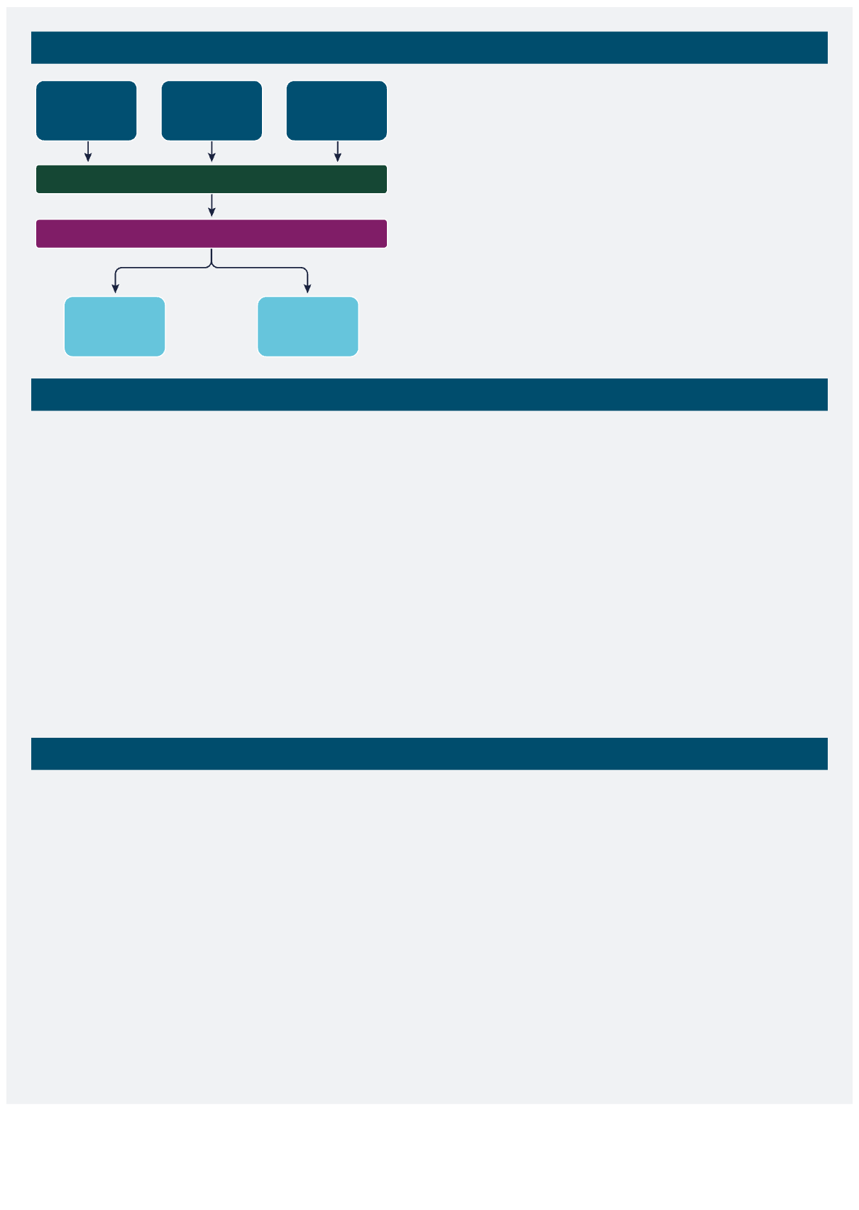

Activity 2: Career path
1. Necessary – What skills and experiences do you need?
Academic
Exploring
Non-academic
(regardlessof your interestinthem)
career
career options
career
Ideas
Skills and experiences required
2. Desirable – What skills and experiences do you want?
(i.e.thatcancontributetoyourpersonal/professionalgoals)
Necessary
Desirable
Activity 3: Timeline of priorities
Take items from your to-do lists and place them in your timeline of priorities, based on the following questions:
1. How much time do you have left to complete your research degree?
2. Which of the skills and experiences in your to-do list are your most immediate priorities?
3. What development activities could help you acquire these skills and experiences and when?
Beginning
Mid
End/final
Post research
stages
stages
stages
degree
Activity 4: Building your DNA ecosystem
Your DNA ecosystem is made up of the tailored network that you build to support you on your professional and career journey.
To create your own ecosystem, reflect on the following questions: 1. What exactly do you want help with?
2. Who are the right people to support and mentor you with this? 3. Why them specifically?
Professional
Social
networks
networks
Me
Research groups and
Other
networks
communities
We gratefully acknowledge that funding for the development of this resource was provided by the University of Edinburgh Development Fund as a project under the Principal’s Teaching Award Scheme (PTAS).
This resource is shared under a Creative Commons Attribution 4.0 (CC BY) licence.
Please acknowledge the University of Edinburgh if you reuse.
Version 1 – July 2025
If you require this document in an alternative format, such as large print or a coloured background, please contact: fiona.philippi@ed.ac.uk

